Slide 1
Topic 5: NORMALIZATION for Relational Database
Ir. Endang Ripmiatin, MT
Program Studi Teknik Informatika
Universitas Al Azhar Indonesia
19 Nov 2015

Slide 2
Informal measures of quality for relation schema design
Semantics of the attributes
Reducing the redundant values in tuples
Reducing the null values in tuples
Disallowing the possibility of generating spurious tuples

Slide 3
1 Informal Design Guidelines for Relational Databases (1)
What is relational database design?
The grouping of attributes to form "good" relation schemas
We first discuss informal guidelines for good relational design
Then we discuss formal concepts of functional dependencies and normal forms
1NF (First Normal Form)
2NF (Second Normal Form)
3NF (Third Normal Form)
BCNF (Boyce-Codd Normal Form)

Slide 4
1.1 Semantics of the Relation Attributes
GUIDELINE 1: Informally, each tuple in a relation should represent one entity or relationship instance. (Applies to individual relations and their attributes).
Attributes of different entities (EMPLOYEEs, DEPARTMENTs, PROJECTs) should not be mixed in the same relation.
Only foreign keys should be used to refer to other entities.
Entity and relationship attributes should be kept apart as much as possible.
Bottom Line: Design a schema that can be explained easily relation by relation. The semantics of attributes should be easy to interpret.

Slide 5
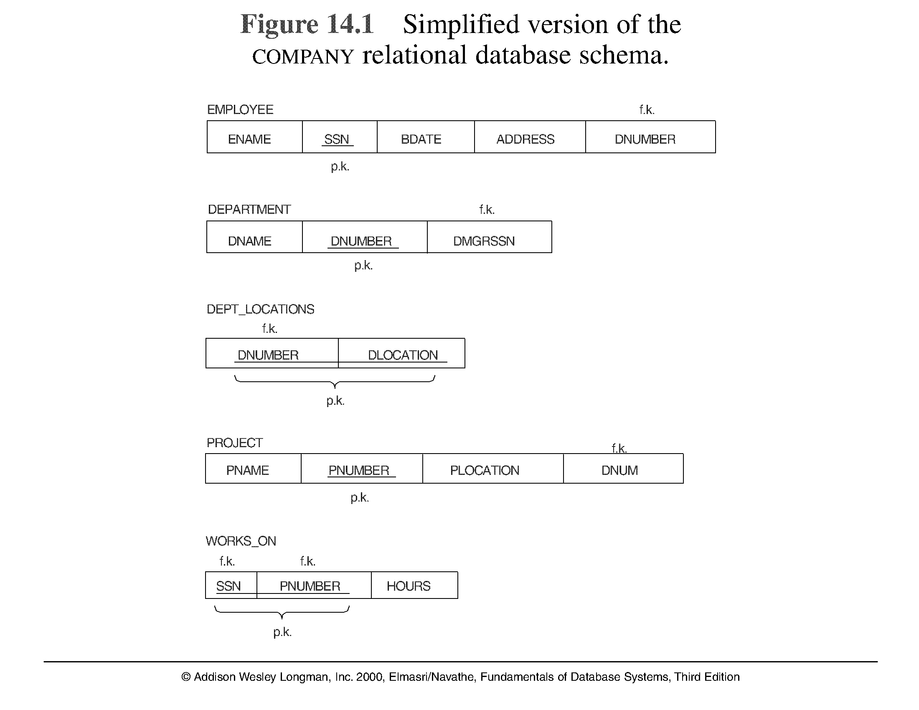
The COMPANY relational database schema
DLOCATION
Multivalued attribute

Slide 6
GUIDELINES in designing tables
GUIDELINE 1: Semantics of the Relation Attributes → each tuple in a relation should represent one entity or relationship instance.
GUIDELINE 2: Design a schema that does not suffer from the insertion, deletion and update anomalies.

Slide 7
1.2 Redundant Information in Tuples and Update Anomalies
Mixing attributes of multiple entities may cause problems
Information is stored redundantly wasting storage
Problems with update anomalies
Insertion anomalies
Deletion anomalies
Modification anomalies

Slide 8
1.2 Redundant Information in Tuples and Update Anomalies
GUIDELINE 2: Design a schema that does not suffer from the insertion, deletion and update anomalies. If there are any present, then note them so that applications can be made to take them into account

Slide 9
EXAMPLE OF AN UPDATE ANOMALY (1)
Consider the relation:
EMP_PROJ ( EmpNumber, ProjNumber, EName, PName, No_hours)
Modification Anomaly: Changing the name of project number P1 from “Billing” to “Customer-Accounting” may cause this update to be made for all 100 employees working on project P1.

Slide 10
EXAMPLE OF AN UPDATE ANOMALY (2)
Insert Anomaly: Cannot insert a project unless an employee is assigned to.
Inversely - Cannot insert an employee unless an he/she is assigned to a project.
Delete Anomaly: When a project is deleted, it will result in deleting all the employees who work on that project. Alternately, if an employee is the sole employee on a project, deleting that employee would result in deleting the corresponding project.

Slide 11
Examples
Table Name: |  | BARANG_PEMASOK
kode_barang | nama_barang | harga_jual | kode_pemasok | nama_pemasok | kota
T-001 | TV ABC 14" | 600.000 | P22 | PT Citra Jaya | Bogor
T-002 | TV ABC 21" | 950.000 | P22 | PT Citra Jaya | Bogor
T-003 | TV XYZ 18" | 450.000 | P11 | PT Amerta | Bandung
T-004 | TV Rhino 29" | 1.750.000 | P33 | PT Kartika | Yogyakarta
T-005 | TV Kirana 14" | 475.000 | P44 | PT Nindya | Tangerang
Explain:
insert anomaly
update anomaly
delete anomaly

Slide 12
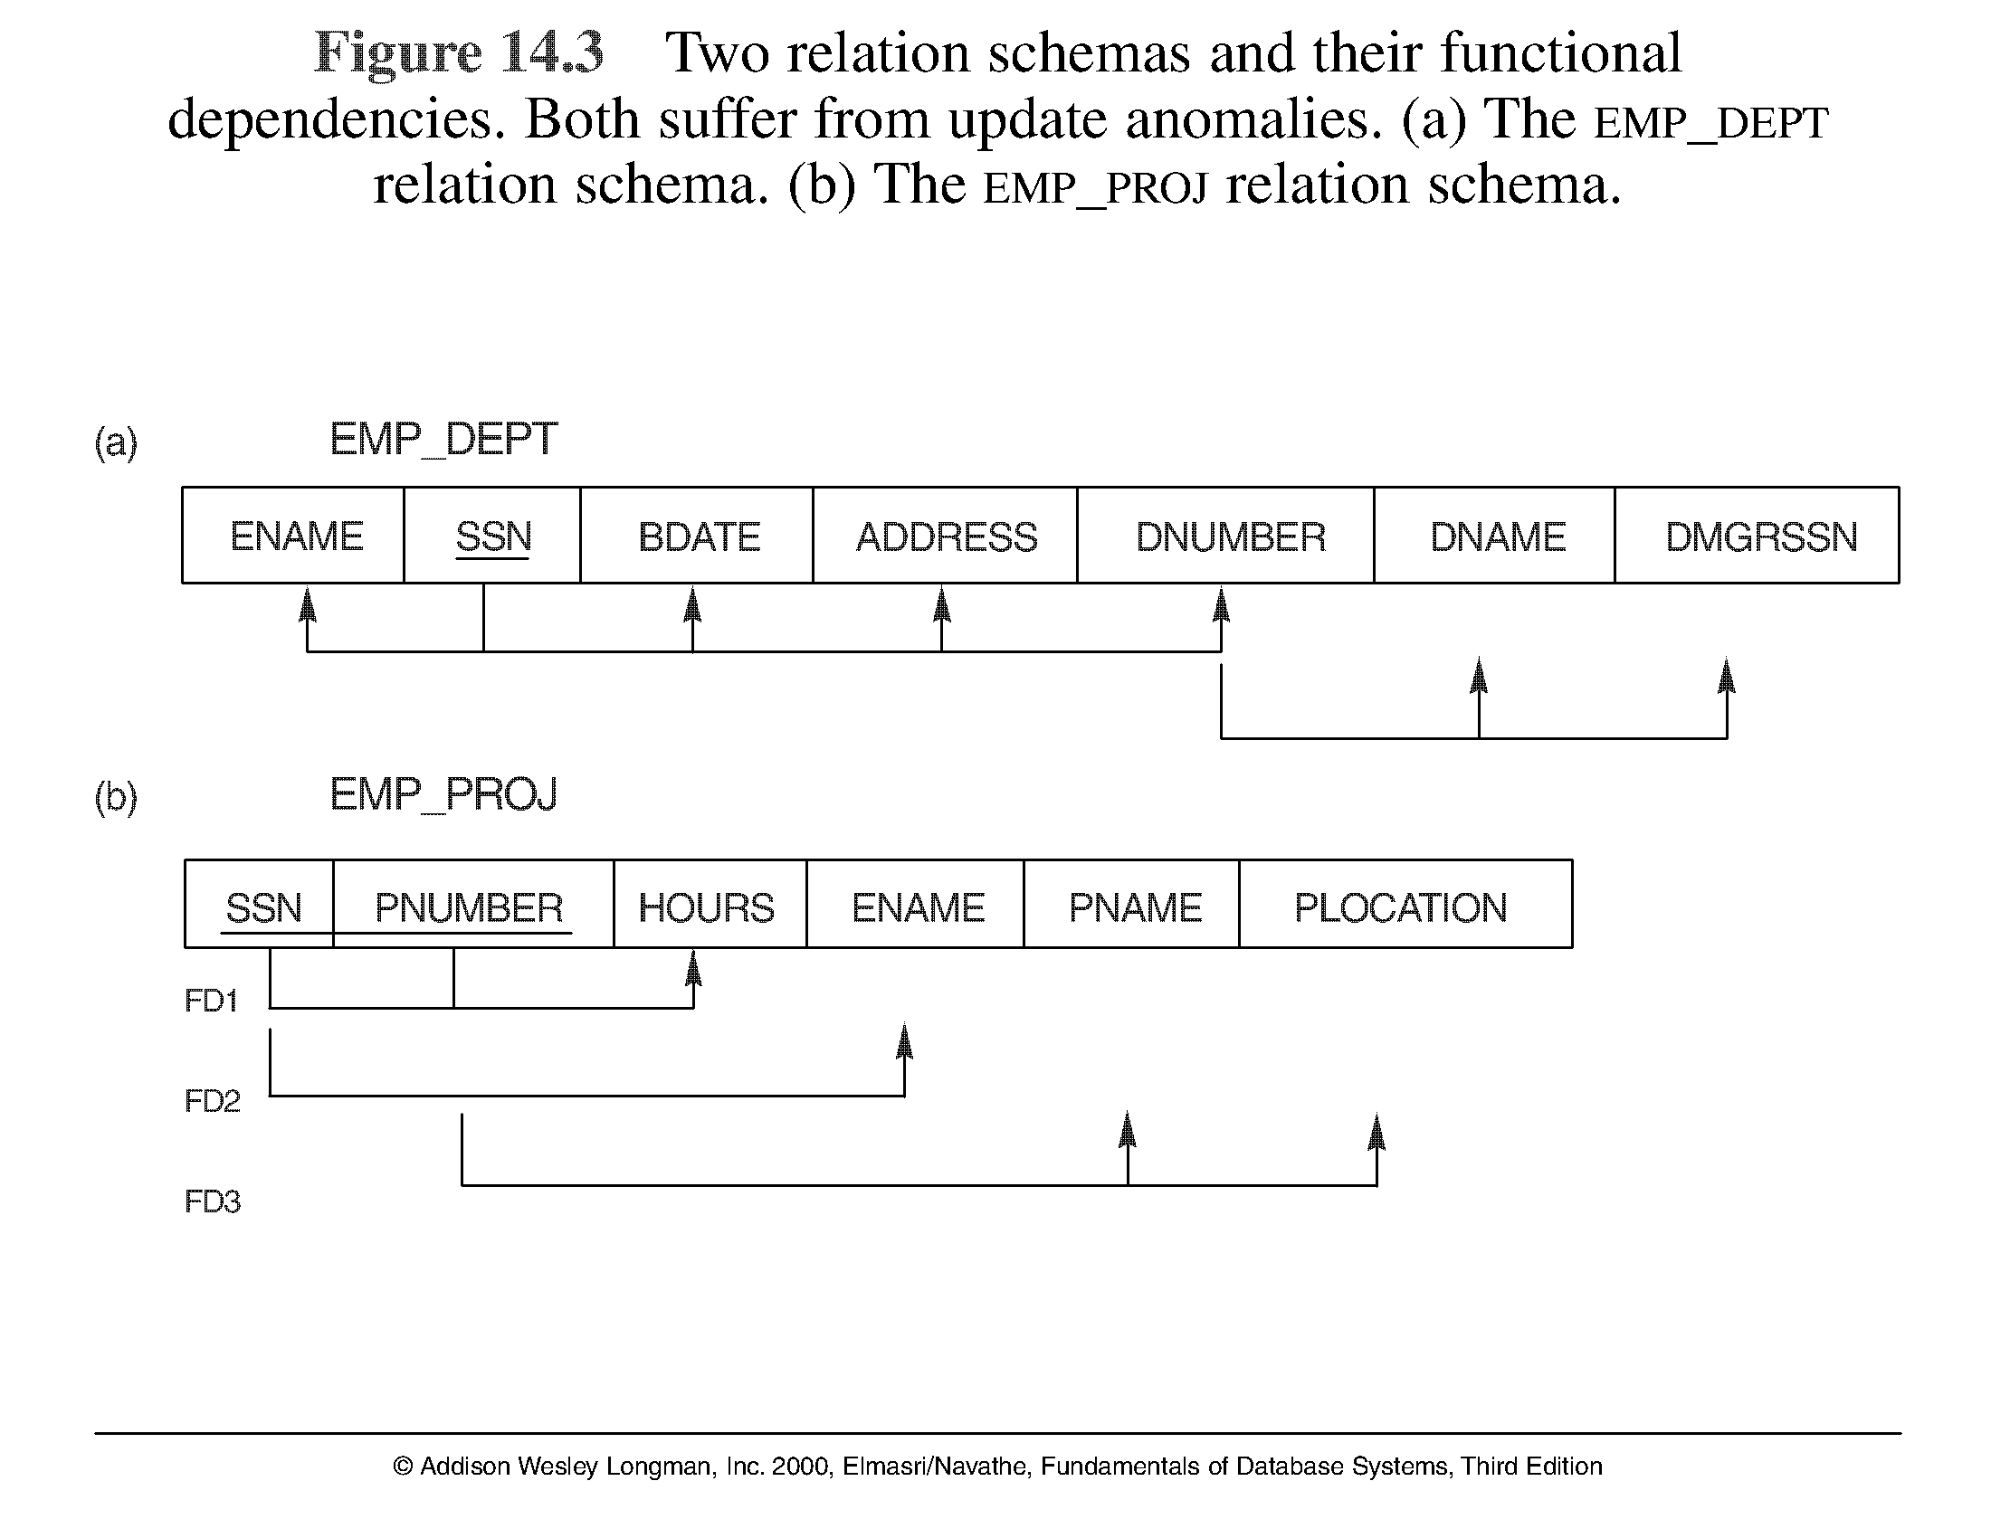
Two relation schemas suffering from update anomalies

Slide 13
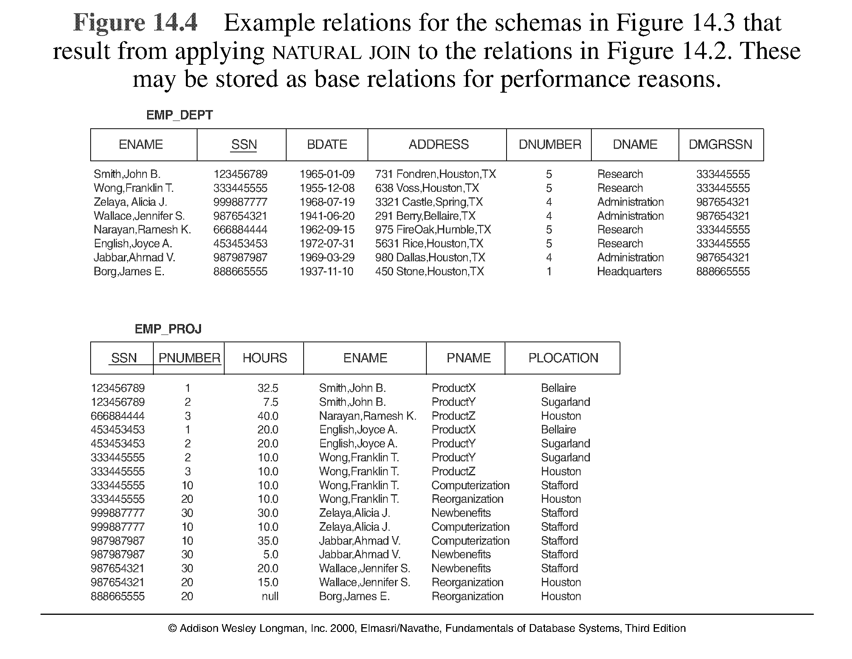
Example States for EMP_DEPT and EMP_PROJ

Slide 14
GUIDELINES in designing tables
GUIDELINE 1: Semantics of the Relation Attributes → each tuple in a relation should represent one entity or relationship instance.
GUIDELINE 2: Design a schema that does not suffer from the insertion, deletion and update anomalies.
GUIDELINE 3: Relations should be designed such that their tuples will have as few NULL values as possible

Slide 15
1.3 Null Values in Tuples
GUIDELINE 3: Relations should be designed such that their tuples will have as few NULL values as possible
Attributes that are NULL frequently could be placed in separate relations (with the primary key)
Multiple interpretation for nulls:
attribute not applicable or invalid
attribute value unknown (may exist)
value known to exist, but unavailable

Slide 16
1.4 Spurious Tuples
Bad designs for a relational database may result in erroneous results for certain JOIN operations
The "lossless join" property is used to guarantee meaningful results for join operations
GUIDELINE 4: The relations should be designed to satisfy the lossless join condition. No spurious tuples should be generated by doing a natural-join of any relations.

Slide 17
Poor design for EMP_PROJ relation
Decomposing EMP_PROJ into EMP_LOCS and EMP_PROJ1 is undesirable because, when we JOIN them back using NATURAL JOIN, we do not get the correct original result.

Slide 18
Spurious Tuples (2)
There are two important properties of decompositions:
non-additive or losslessness of the corresponding join
preservation of the functional dependencies.
Note that property (a) is extremely important and cannot be sacrificed. Property (b) is less stringent and may be sacrificed.

Slide 19
GUIDELINES in designing tables
GUIDELINE 1: Semantics of the Relation Attributes → each tuple in a relation should represent one entity or relationship instance.
GUIDELINE 2: Design a schema that does not suffer from the insertion, deletion and update anomalies.
GUIDELINE 3: Relations should be designed such that their tuples will have as few NULL values as possible.
GUIDELINE 4: The relations should be designed to satisfy the lossless join condition.

Slide 20
2.1 Functional Dependencies (1)
Functional dependencies (FDs) are used to specify formal measures of the "goodness" of relational designs
FDs and keys are used to define normal forms for relations
FDs are constraints that are derived from the meaning and interrelationships of the data attributes
A set of attributes X functionally determines a set of attributes Y if the value of X determines a unique value for Y

Slide 21
Functional Dependencies (2)
X → Y holds if whenever two tuples have the same value for X, they must have the same value for Y
X determines Y
For any two tuples t1 and t2 in any relation instance r(R): If t1[X]=t2[X], then t1[Y]=t2[Y]
X → Y in R specifies a constraint on all relation instances r(R)
FDs are derived from the real-world constraints on the attributes

Slide 22
Examples of FD constraints (1)
social security number determines employee name
SSN → ENAME
project number determines project name and location
PNUMBER → {PNAME, PLOCATION}
employee ssn and project number determines the hours per week that the employee works on the project
{SSN, PNUMBER} → HOURS

Slide 23
Examples of FD constraints (2)
An FD is a property of the attributes in the schema R
The constraint must hold on every relation instance r(R)
If K is a key of R, then K functionally determines all attributes in R (since we never have two distinct tuples with t1[K]=t2[K])

Slide 24
3 Normal Forms Based on Primary Keys
3.1 Normalization of Relations
3.2 Practical Use of Normal Forms
3.3 Definitions of Keys and Attributes Participating in Keys
3.4 First Normal Form
3.5 Second Normal Form
3.6 Third Normal Form

Slide 25
3.1 Normalization of Relations (1)
Normalization: The process of decomposing unsatisfactory "bad" relations by breaking up their attributes into smaller relations
Normal form: Condition using keys and FDs of a relation to certify whether a relation schema is in a particular normal form

Slide 26
Normalization of Relations (2)
2NF, 3NF, BCNF based on keys and FDs of a relation schema
4NF based on keys, multi-valued dependencies : MVDs; 5NF based on keys, join dependencies : JDs
Additional properties may be needed to ensure a good relational design (lossless join, dependency preservation)

Slide 27
3.2 Practical Use of Normal Forms
Normalization is carried out in practice so that the resulting designs are of high quality and meet the desirable properties
The practical utility of these normal forms becomes questionable when the constraints on which they are based are hard to understand or to detect
The database designers need not normalize to the highest possible normal form. (usually up to 3NF, BCNF or 4NF)
Denormalization: the process of storing the join of higher normal form relations as a base relation—which is in a lower normal form

Slide 28
3.3 Definitions of Keys and Attributes Participating in Keys (1)
A superkey of a relation schema R = {A1, A2, ...., An} is a set of attributes S subset-of R with the property that no two tuples t1 and t2 in any legal relation state r of R will have t1[S] = t2[S]
A key K is a superkey with the additional property that removal of any attribute from K will cause K not to be a superkey any more.
{SSN} is a key for EMPLOYEE
{SSN}, {SSN, ENAME}, {SSN, ENAME, DNUM} and any set of attributes that include SSN are all superkeys.

Slide 29
Definitions of Keys and Attributes Participating in Keys (2)
If a relation schema has more than one key, each is called a candidate key. One of the candidate keys is arbitrarily designated to be the primary key, and the others are called secondary keys.
A Prime attribute must be a member of some candidate key
A Nonprime attribute is not a prime attribute—that is, it is not a member of any candidate key.
In WORKS_ON: SSN and PNUMBER are prime attributes, whereas other attributes are nonprime.

Slide 30
3.2 First Normal Form
Disallows composite attributes, multivalued attributes, and nested relations; attributes whose values for an individual tuple are non-atomic
Considered to be part of the formal definition of relation in the basic (flat) relational model

Slide 31
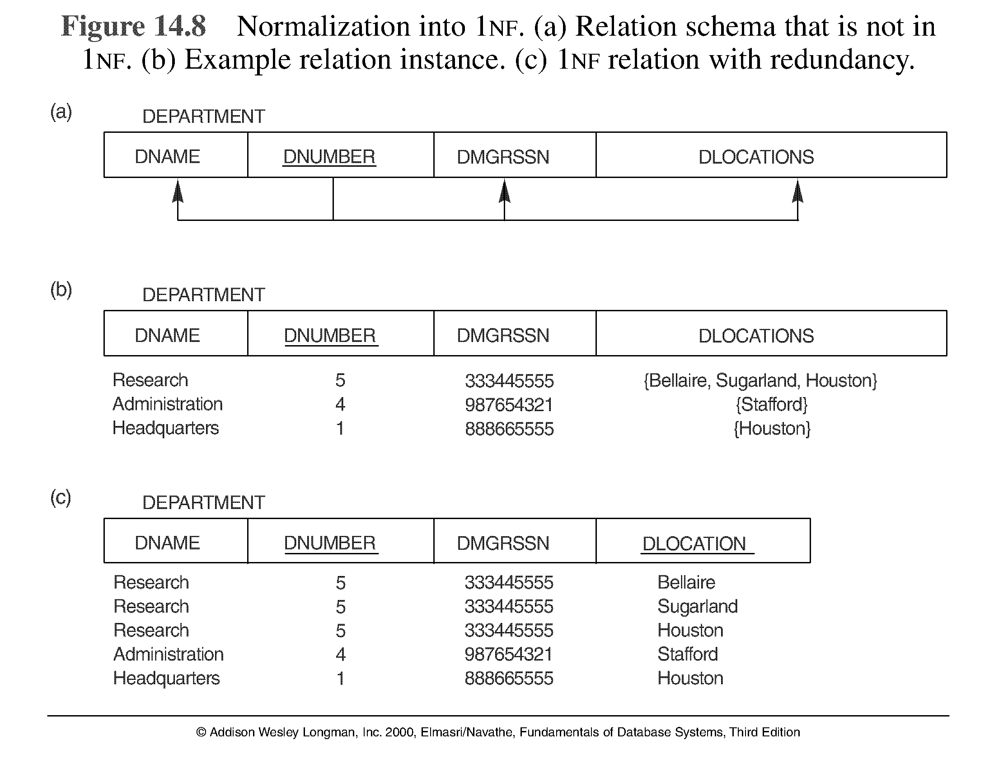
Normalization into 1NF
Do not allow multi-valued
DEPARTMENT_1NF

Slide 32
Normalization into 1NF
Three main techniques to achieve 1NF in the Figure 14.8 condition:
Remove attribute DLOCATIONS and place it in a separate DEPT_LOCATIONS along with the primary key DNUMBER of DEPARTMENT
Expand the key so that there will be a separate tuple in the original DEPARTMENT for each location of DEPARTMENT. In this case primary key becomes [DNUMBER, DLOCATION]
If a maximum number of values is known for the attribute – e.g. at most 3 locations – replace DLOCATION attribute by three atomic attributes: DLOCATION1, DLOCATION2, DLOCATION3

Slide 33
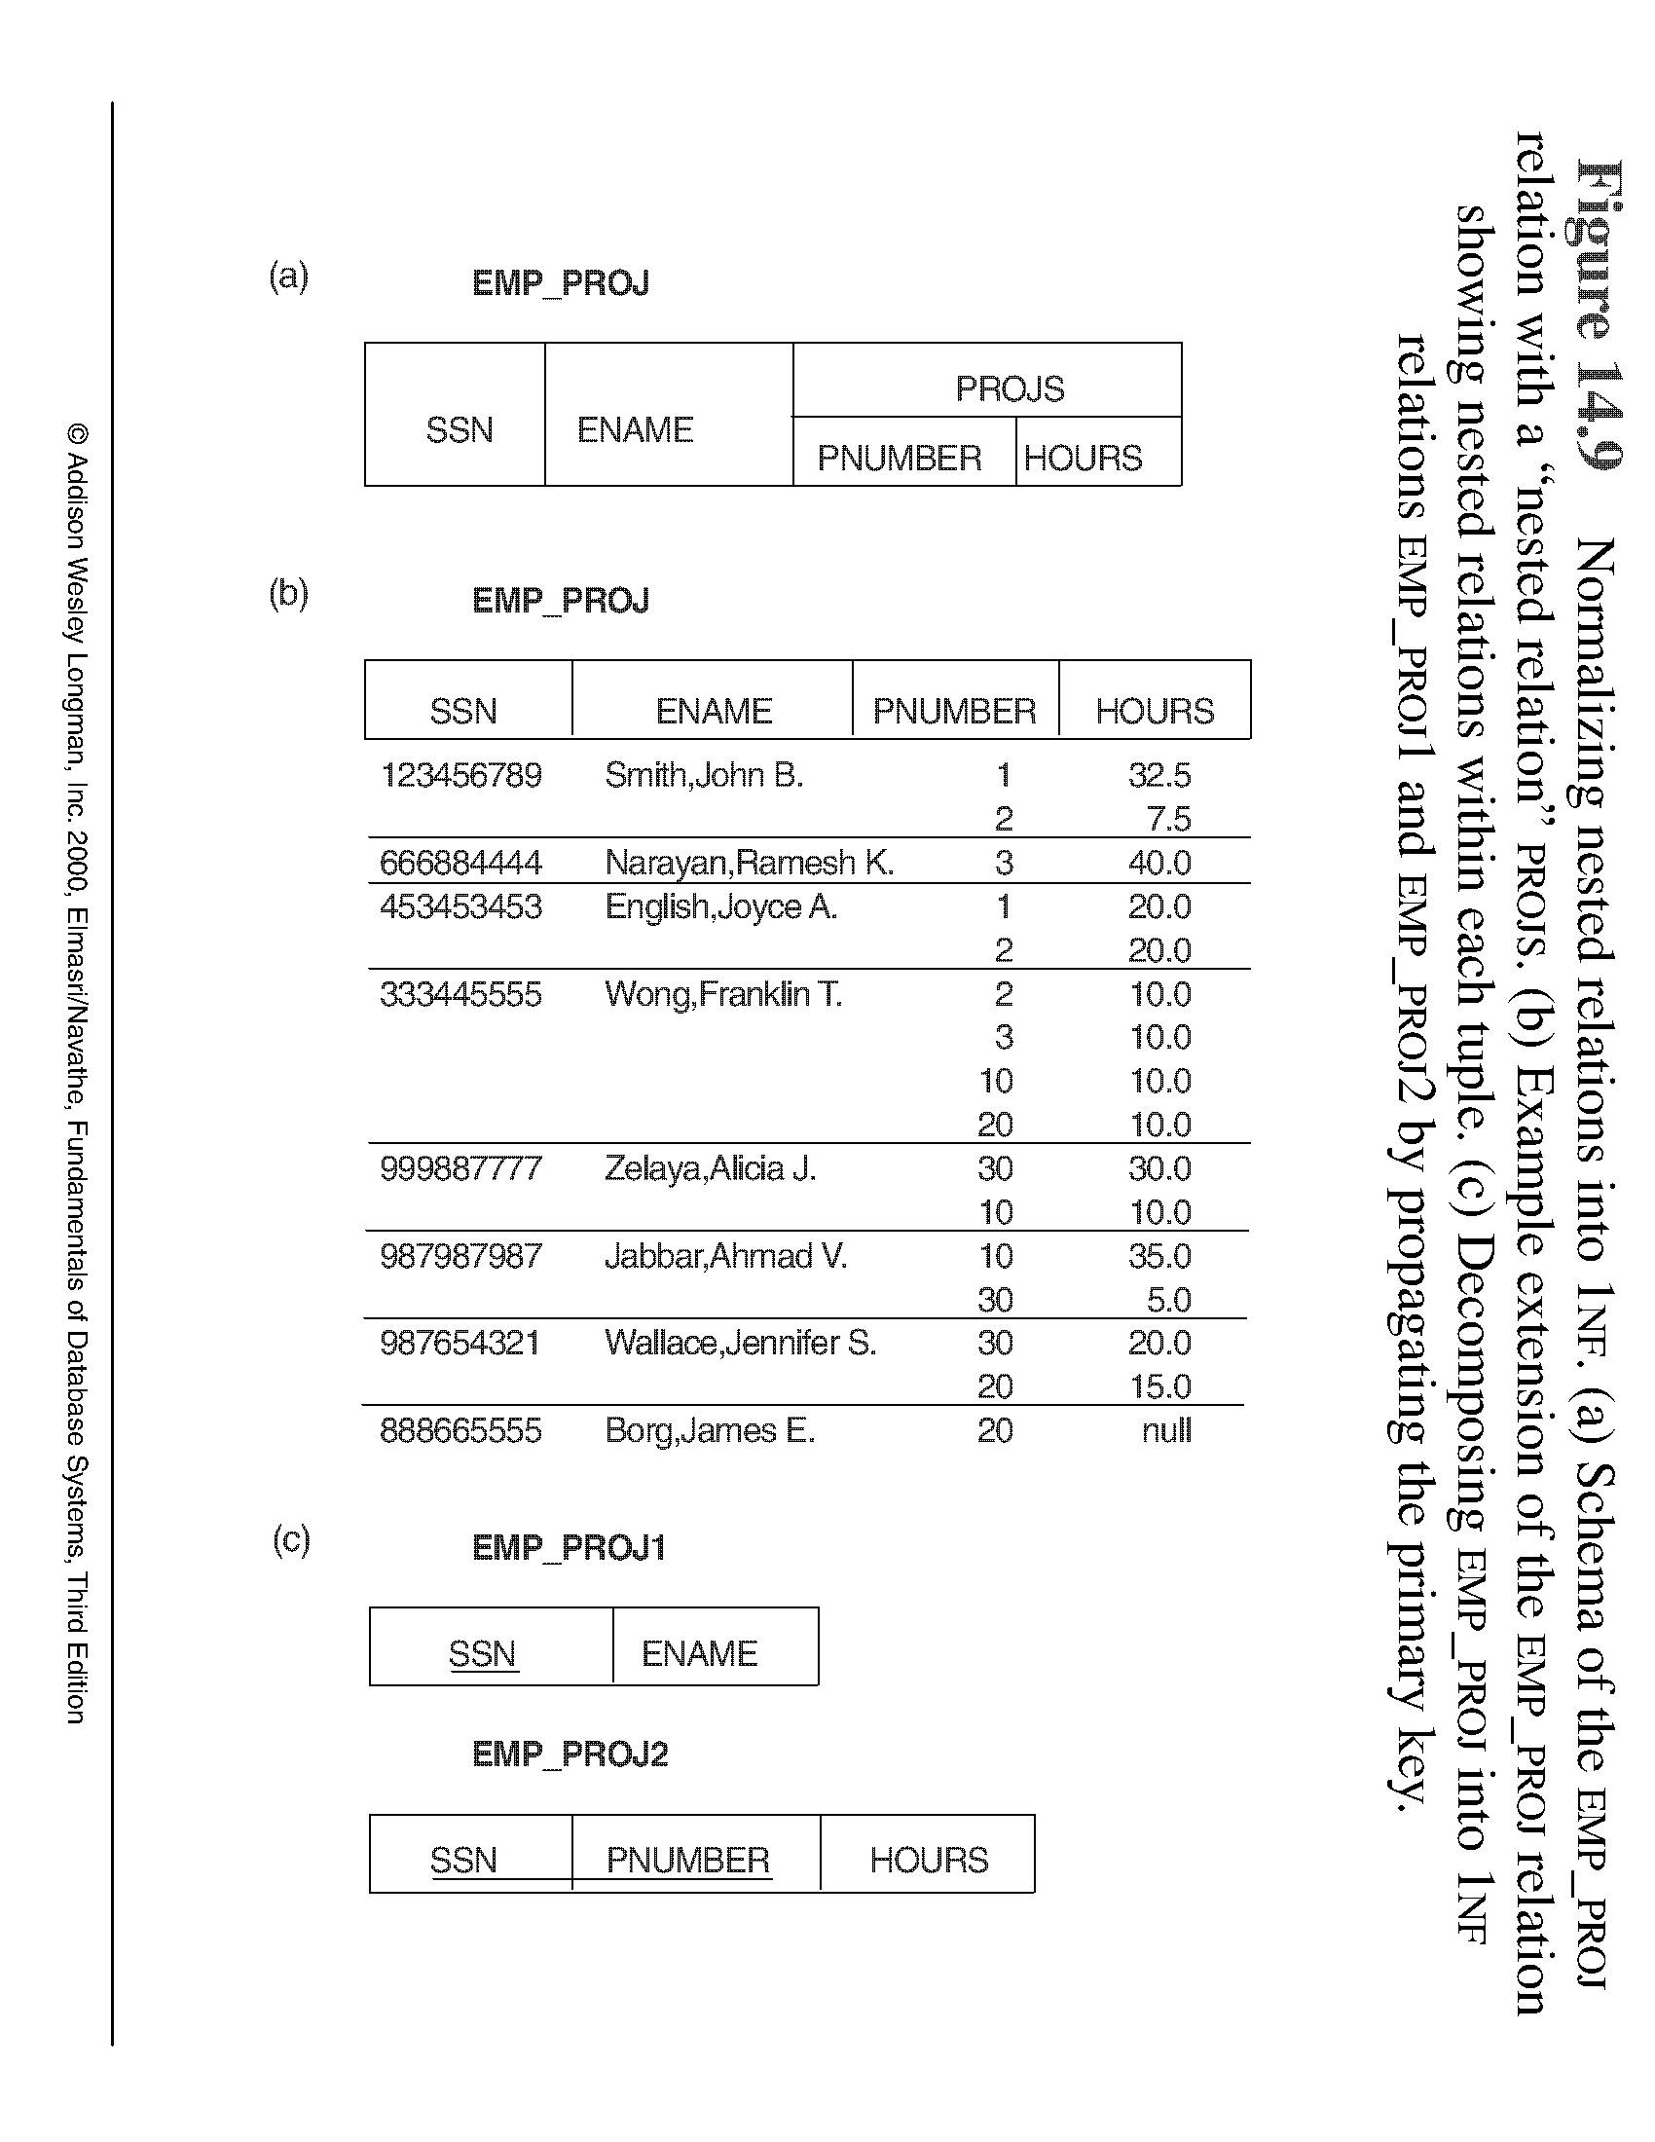
Normalization nested relations into 1NF
To normalize into 1NF:
Remove the nested relation attributes into a new relation
Propagate the primary key into the new relations
SOAL:

Slide 34
3.3 Second Normal Form (1)
Uses the concepts of FDs, primary key
Definitions:
Prime attribute - attribute that is member of the primary key K
Full functional dependency - a FD Y → Z where removal of any attribute from Y means the FD does not hold any more
Examples:
{SSN, PNUMBER} → HOURS is a full FD since neither SSN → HOURS nor PNUMBER → HOURS hold
{SSN, PNUMBER} → ENAME is not a full FD (it is called a partial dependency ) since SSN → ENAME also holds

Slide 35
Second Normal Form (2)
Definition:
A relation schema R is in second normal form (2NF) if every non-prime attribute A in R is fully functionally dependent on the primary key
R can be decomposed into 2NF relations via the process of 2NF normalization
FD of not ??
35

Slide 36
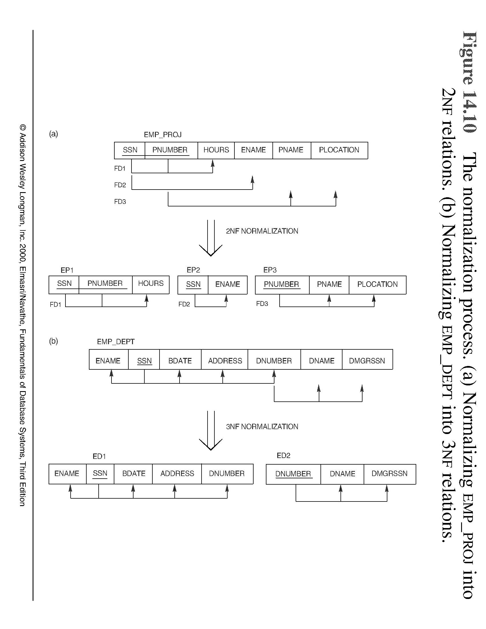
Normalization into 2NF
Test for 2NF:
If primary key is a single attribut → do not need to test.
Every non-prime attribute A in R is fully FD on the primary key
SOAL

Slide 37
Summary of previous meeting 1 NF and 2 NF
1 NF – disallow composite attributes, multivalued attributes, and nested relations.
eliminate composite attributes, multivalued attributes, and nested relations (attributes whose values for an individual tuple are non-atomic)
2 NF – every non-prime attribute A in R is fully functionally dependent on the primary key
eliminate partial dependenties

Slide 38
Normalization into 1NF
Do not allow multi-valued
DEPARTMENT_1NF

Slide 39
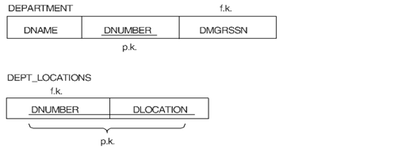
Normalization into 2NF
{DNUMBER, DLOCATION} → DNAME is not a full FD (it is called a partial dependency ) since DNUMBER → DNAME also holds
FD of not ??

Slide 40
3.4 Third Normal Form (1)
Definition:
Transitive functional dependency - a FD X → Z that can be derived from two FDs X → Y and Y → Z
Examples:
SSN → DMGRSSN is a transitive FD since SSN → DNUMBER and DNUMBER → DMGRSSN hold
SSN → ENAME is non-transitive since there is no set of attributes X where SSN → X and X → ENAME

Slide 41
Third Normal Form (2)
A relation schema R is in third normal form (3NF) if it is in 2NF and no non-prime attribute A in R is transitively dependent on the primary key
R can be decomposed into 3NF relations via the process of 3NF normalization
NOTE:
In X → Y and Y → Z, with X as the primary key, we consider this a problem only if Y is not a candidate key. When Y is a candidate key, there is no problem with the transitive dependency .
E.g., Consider EMP (SSN, EmpNumber, Salary ).
Here, SSN → EmpNumber → Salary and EmpNumber is a candidate key.

Slide 42
4. General Normal Form Definitions (For Multiple Keys) (1)
The above definitions consider the primary key only
The following more general definitions take into account relations with multiple candidate keys
A relation schema R is in second normal form (2NF) if every non-prime attribute A in R is fully functionally dependent on every key of R

Slide 43
General Normal Form Definitions (2)
Definition:
Superkey of relation schema R - a set of attributes S of R that contains a key of R
A relation schema R is in third normal form (3NF) if whenever a FD X → A holds in R, then either:
(a) X is a superkey of R, or
(b) A is a prime attribute of R
NOTE: Boyce-Codd normal form disallows condition (b) above

Slide 44
5. BCNF (Boyce-Codd Normal Form)
A relation schema R is in Boyce-Codd Normal Form (BCNF) if whenever an FD X → A holds in R, then X is a superkey of R
Each normal form is strictly stronger than the previous one
Every 2NF relation is in 1NF
Every 3NF relation is in 2NF
Every BCNF relation is in 3NF
There exist relations that are in 3NF but not in BCNF
The goal is to have each relation in BCNF (or 3NF)

Slide 45
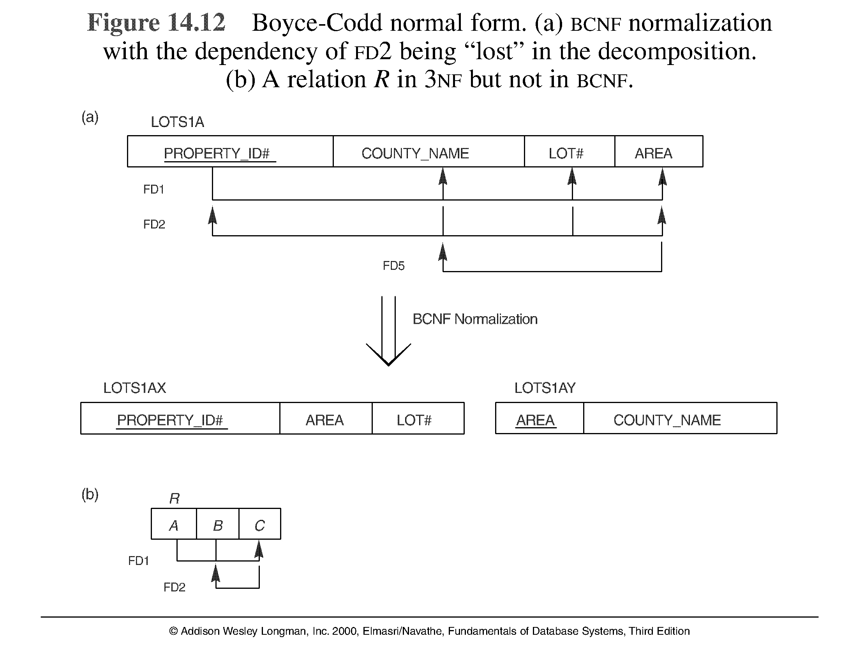
Boyce-Codd normal form

Slide 46
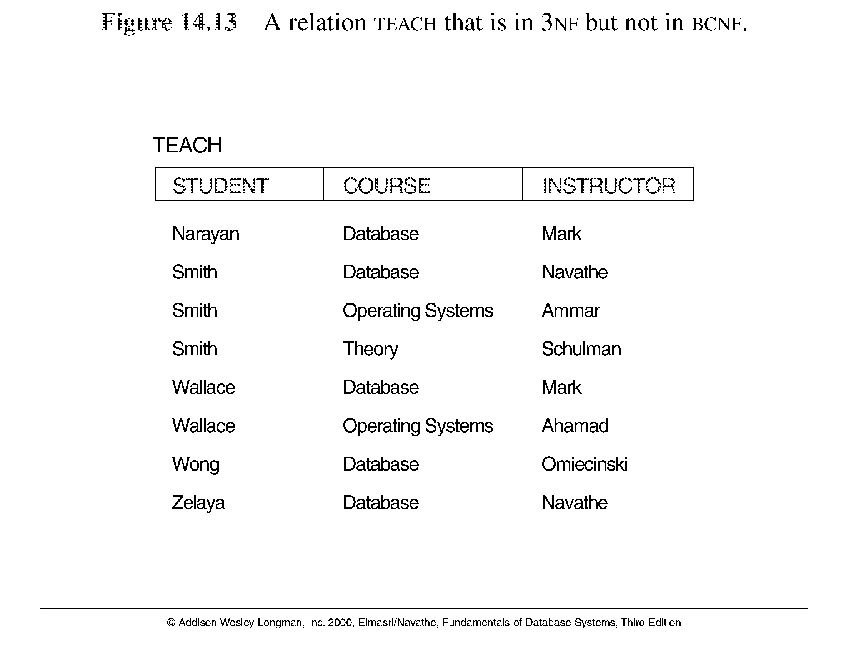
A relation TEACH that is in 3NF but not in BCNF

Slide 47
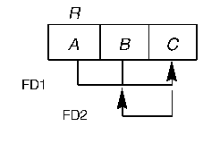
Achieving the BCNF by Decomposition (1)
Two FDs exist in the relation TEACH:
FD1: { student, course} → instructor
FD2: instructor → course
{student, course} is a candidate key for this relation and that the dependencies shown follow the pattern in Figure 14.12 (b). So this relation is in 3NF but not in BCNF
A relation NOT in BCNF should be decomposed so as to meet this property, while possibly forgoing the preservation of all functional dependencies in the decomposed relations.

Slide 48
Achieving the BCNF by Decomposition (2)
Three possible decompositions for relation TEACH
{student, instructor} and {student, course}
{course, instructor } and {course, student}
{instructor, course } and {instructor, student}
All three decompositions will lose FD1. We have to settle for sacrificing the functional dependency preservation. But we cannot sacrifice the non-additivity property after decomposition.
Out of the above three, only the 3rd decomposition will not generate spurious tuples after join.(and hence has the non-additivity property).

Slide 49
Exercise:
Identify FD
Illustrate the normalization process to 1NF, 2NF, 3NF dan BCNF

